Slide 1
AEM Solr Integration
Mayur Gajbhiye
Programmer, Bodex llc

Slide 2
AEM Solr Integration

Slide 3
Tools Required
AEM 6.0
Solr
Java 7
Maven 3.2.5 (Other Versions are having some bugs)
Vault
Eclipse IDE J2EE
Notes:
Everyone at Bodex believes that incorporating these values in our daily lives will improve the quality of our deliverables and interaction on a day to day basis and help us also be good human beings as such. PRINT and Have a copy of this and Mission statement and READ every day as we start work.

Slide 4
Prerequisites
AEM Public Repository is added to Maven profile
Please use Maven 3.2.5 specific to your platform, other versions are having some bug
Check that Maven’s Environment variables are set properly,
PATH
JAVA_HOME
M2_HOME
M2
Check vault Configuration properly and set its path in env-var
PATH
Type to check current version:
mvn –version
vlt -v

Slide 5
AEM Solr Integration
Getting Started

Slide 6
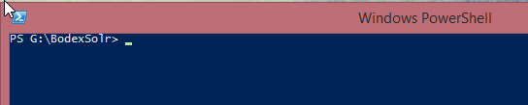
Workspace
Choose a workspace for Storing AEM Solr Project

Slide 7
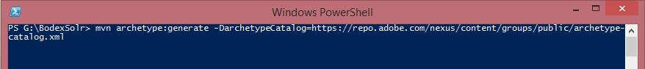
AEM project creation
Generate AEM Project from Adobe AEM archetype
mvn archetype:generate -DarchetypeCatalog=https://repo.adobe.com/nexus/content/groups/public/archetype-catalog.xml

Slide 8
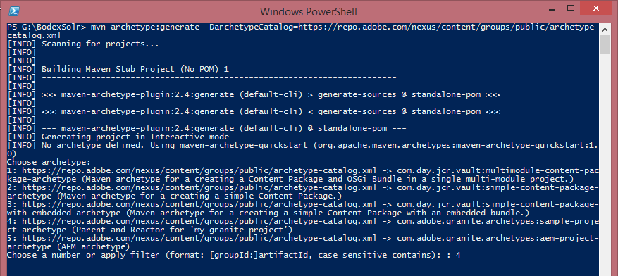
AEM project creation
Generate AEM Project from Adobe AEM archetype
Choose : 4
Set other properties

Slide 9
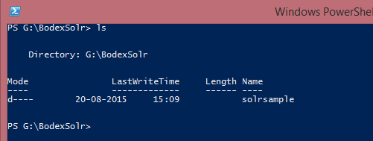
AEM project creation
Generate AEM Project from Adobe AEM archetype
project

Slide 10

AEM project creation
Generate AEM Project from Adobe AEM archetype
project

Slide 11
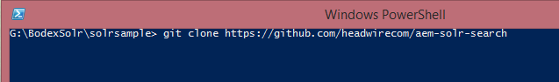
AEM project creation
Generate AEM Project from Adobe AEM archetype
project

Slide 12
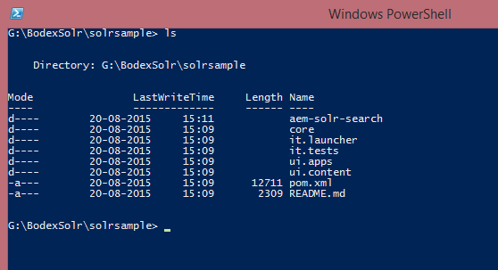
AEM project creation
Generate AEM Project from Adobe AEM archetype
project

Slide 13
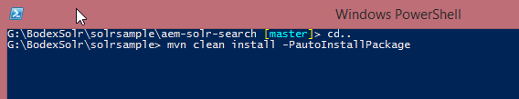
AEM project creation
Generate AEM Project from Adobe AEM archetype
project

Slide 14
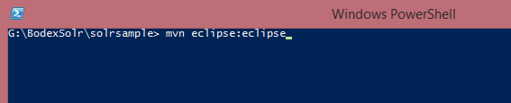
AEM project creation
Generate AEM Project from Adobe AEM archetype
project

Slide 15
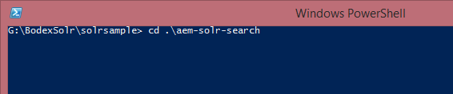
AEM project creation
Generate AEM Project from Adobe AEM archetype
project

Slide 16
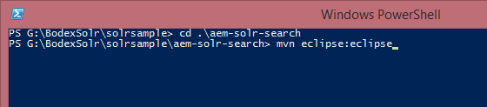
AEM project creation
Generate AEM Project from Adobe AEM archetype
project

Slide 17
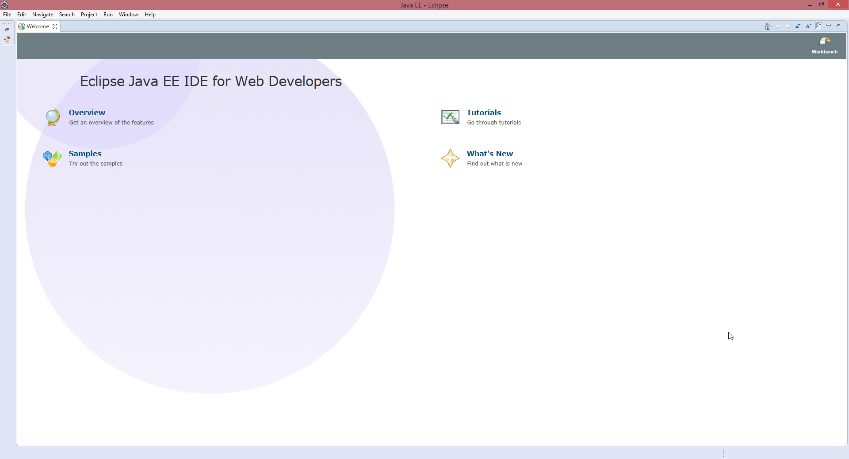
AEM project creation
Generate AEM Project from Adobe AEM archetype
project

Slide 18
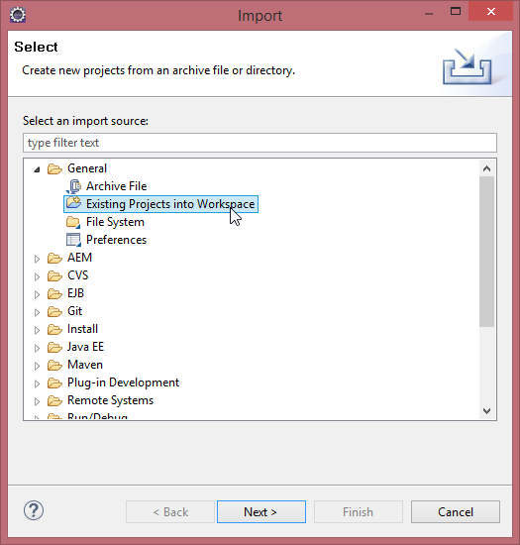
AEM project creation
Generate AEM Project from Adobe AEM archetype
project

Slide 19
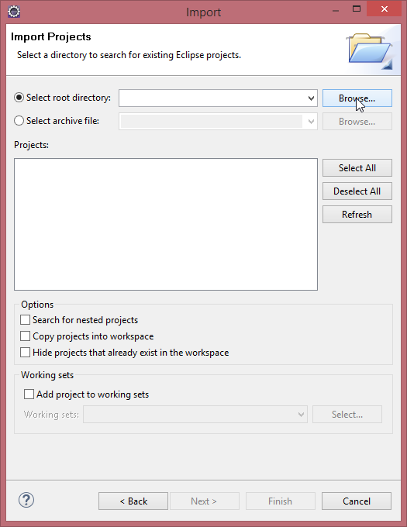
AEM project creation
Generate AEM Project from Adobe AEM archetype
project

Slide 20
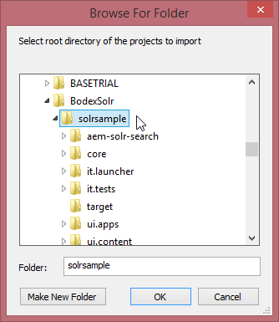
AEM project creation
Generate AEM Project from Adobe AEM archetype
project

Slide 21
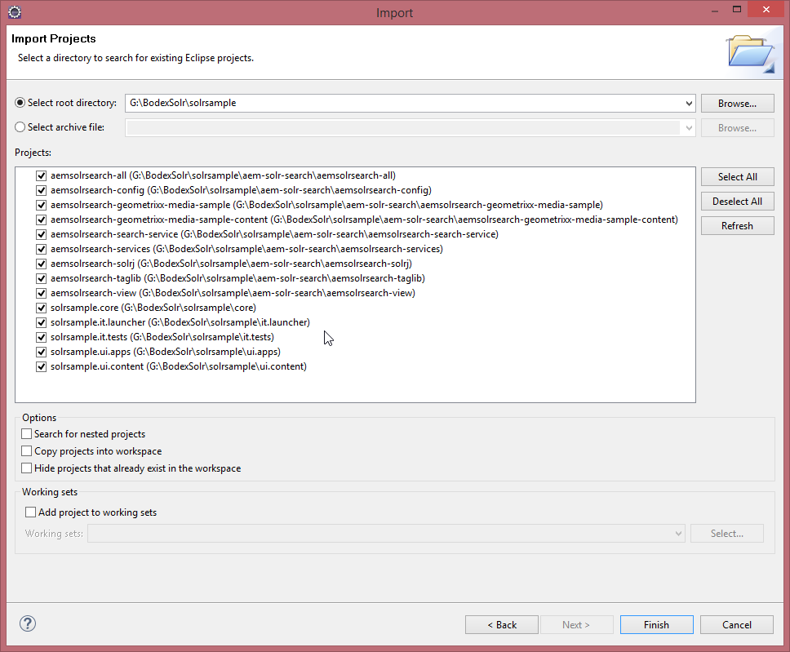
AEM project creation
Generate AEM Project from Adobe AEM archetype
project

Slide 22
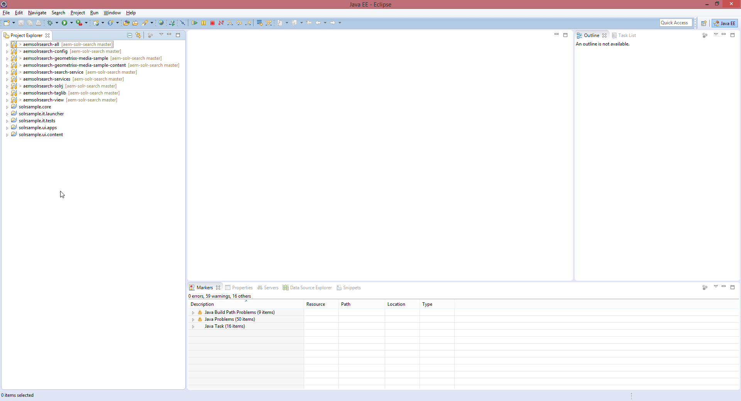
AEM project creation
Generate AEM Project from Adobe AEM archetype
project

Slide 23
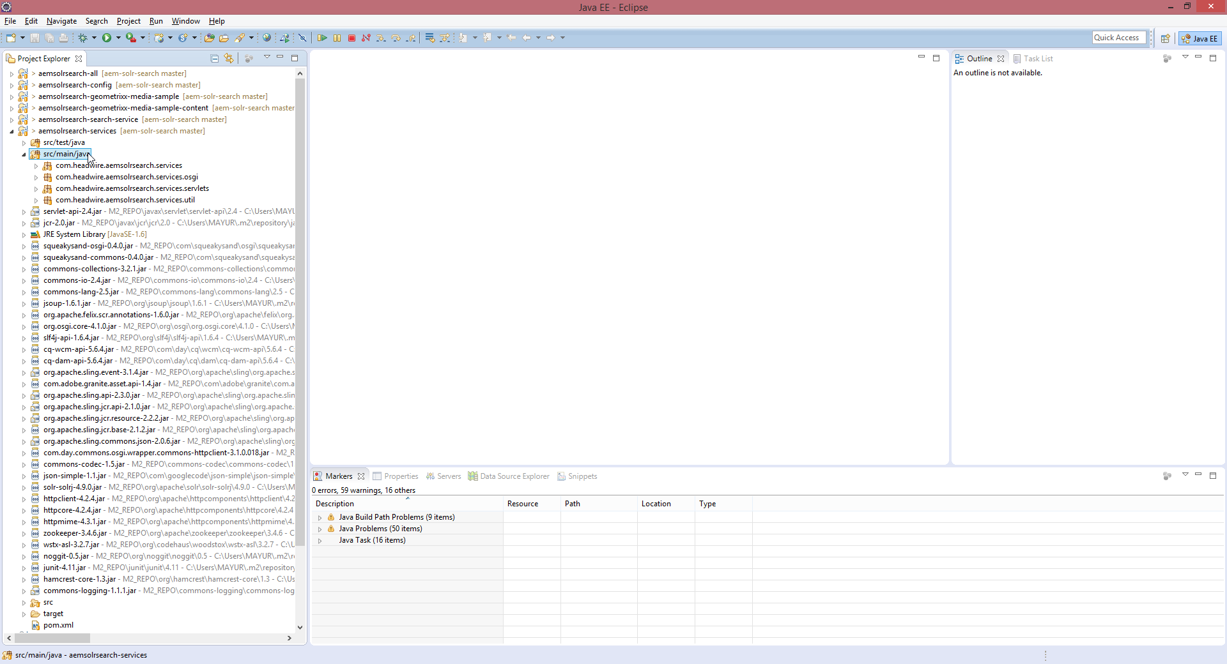
AEM project creation
Generate AEM Project from Adobe AEM archetype
project

Slide 24

AEM project creation
Generate AEM Project from Adobe AEM archetype
project

Slide 25
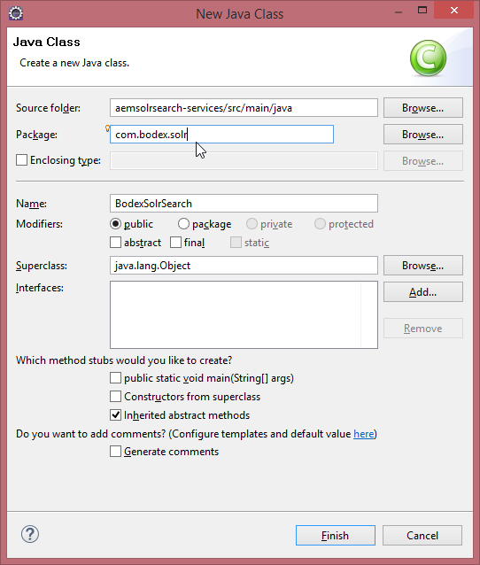
AEM project creation
Generate AEM Project from Adobe AEM archetype
project

Slide 26
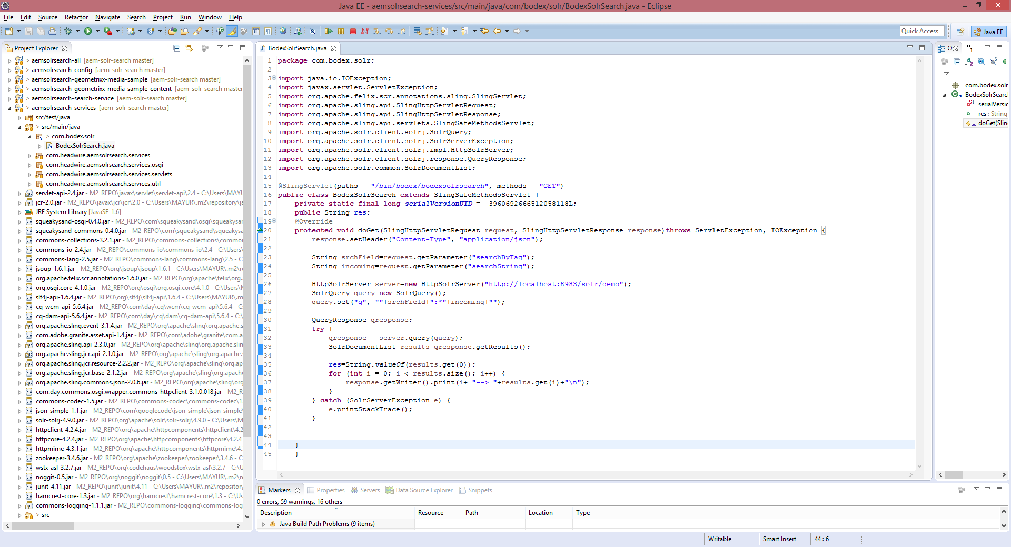
AEM project creation
Generate AEM Project from Adobe AEM archetype
project

Slide 27
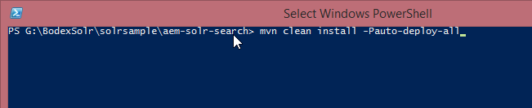
AEM project creation
Generate AEM Project from Adobe AEM archetype
project

Slide 28
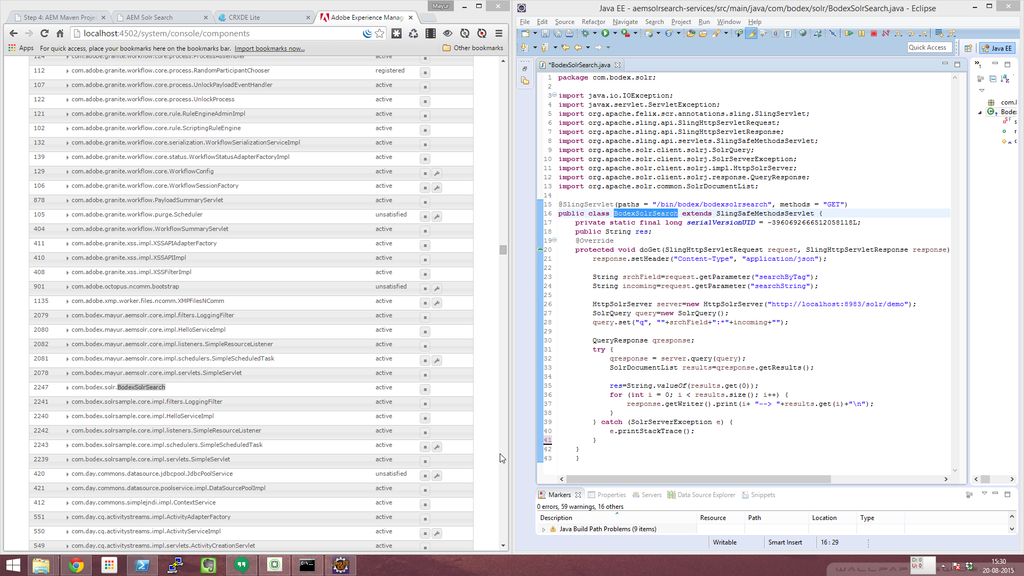
AEM project creation
Generate AEM Project from Adobe AEM archetype
project

Slide 29
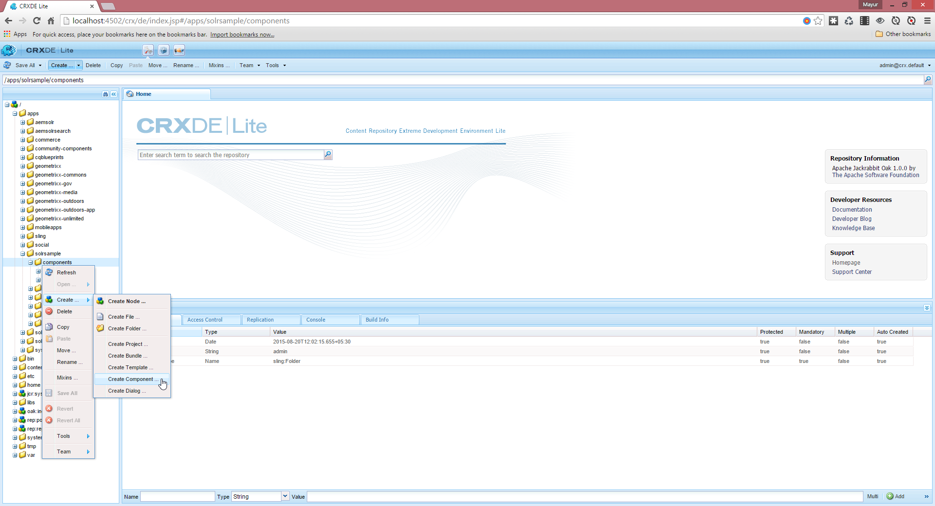
AEM project creation
Generate AEM Project from Adobe AEM archetype
project

Slide 30
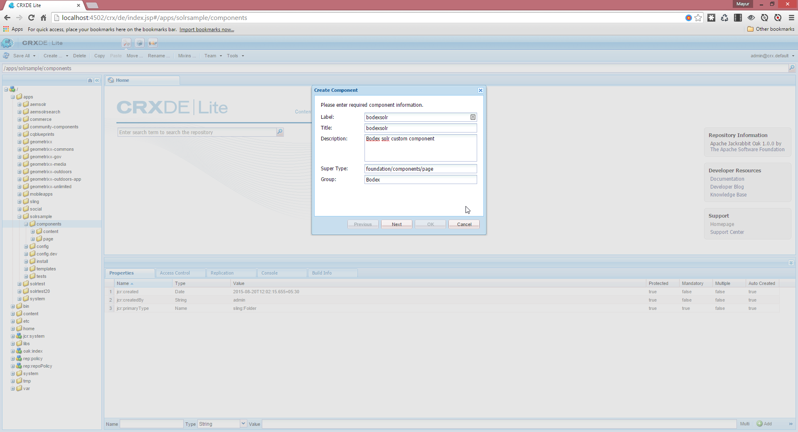
AEM project creation
Generate AEM Project from Adobe AEM archetype
project

Slide 31
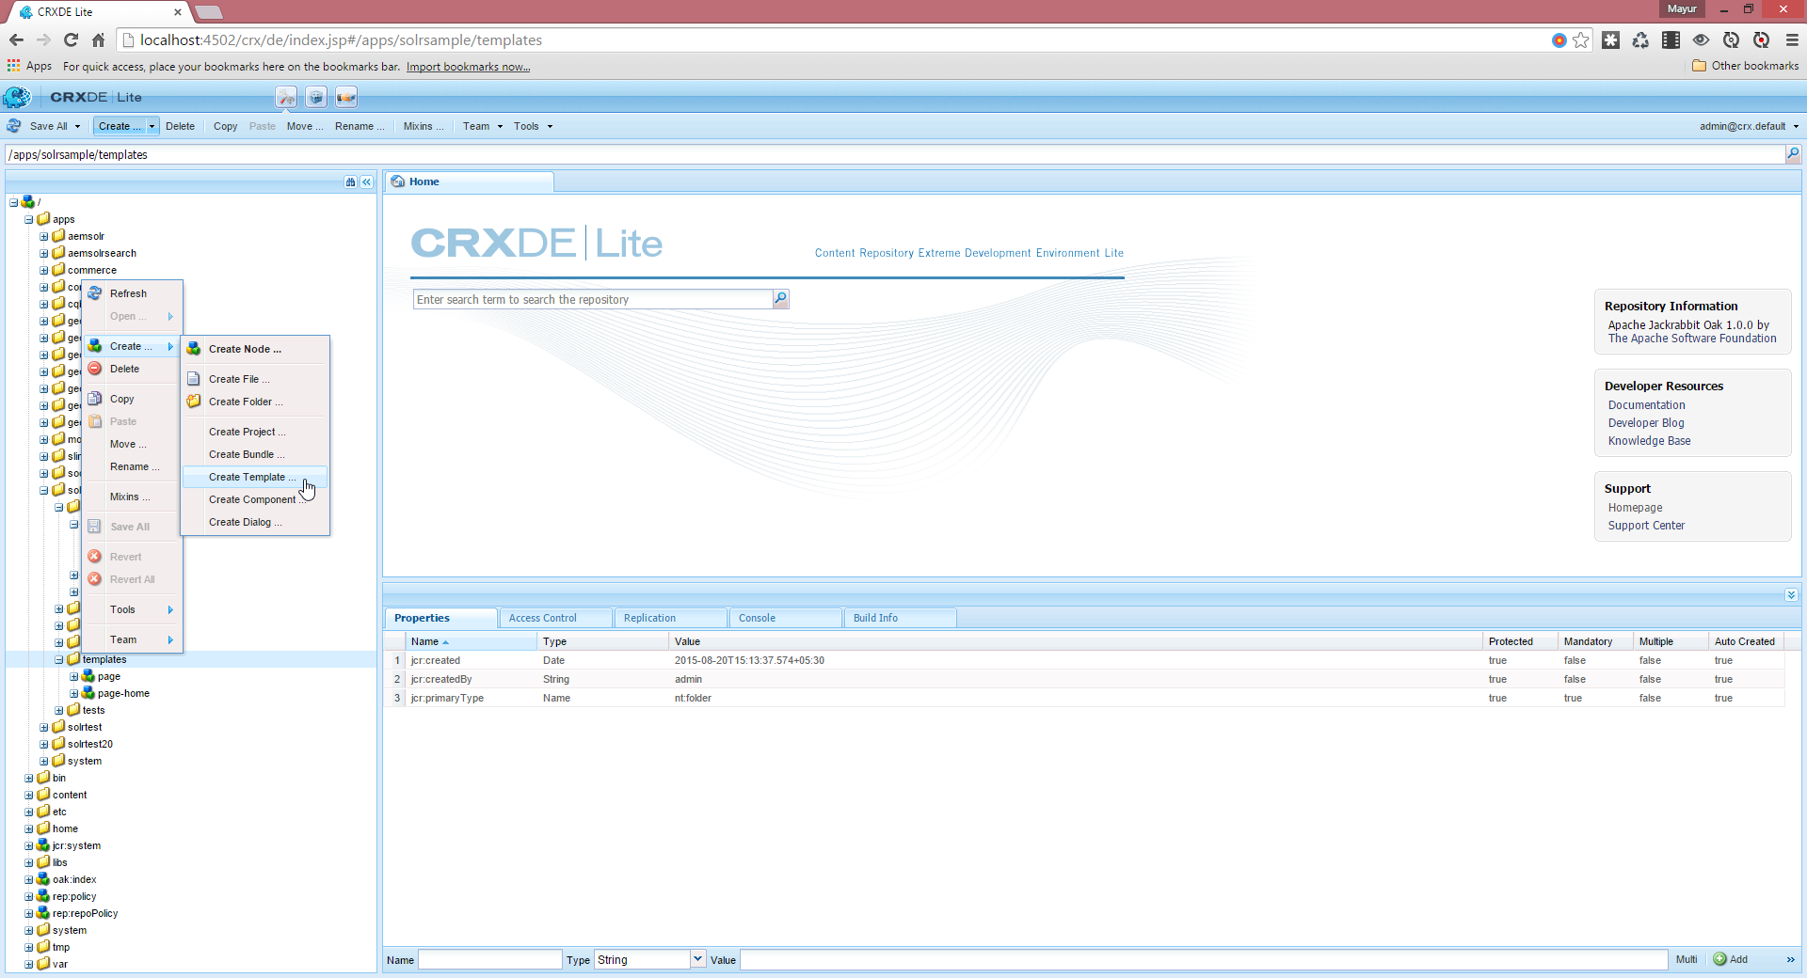
AEM project creation
Generate AEM Project from Adobe AEM archetype
project

Slide 32
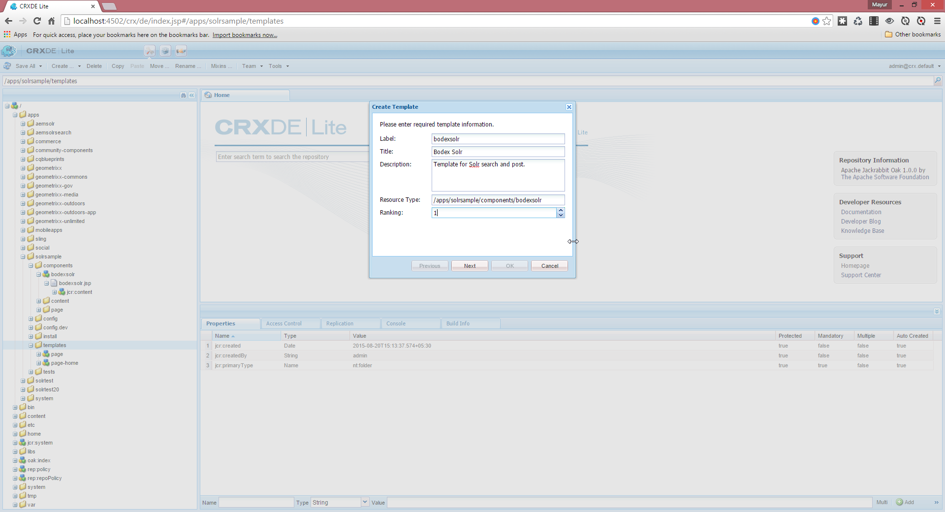
AEM project creation
Generate AEM Project from Adobe AEM archetype
project

Slide 33
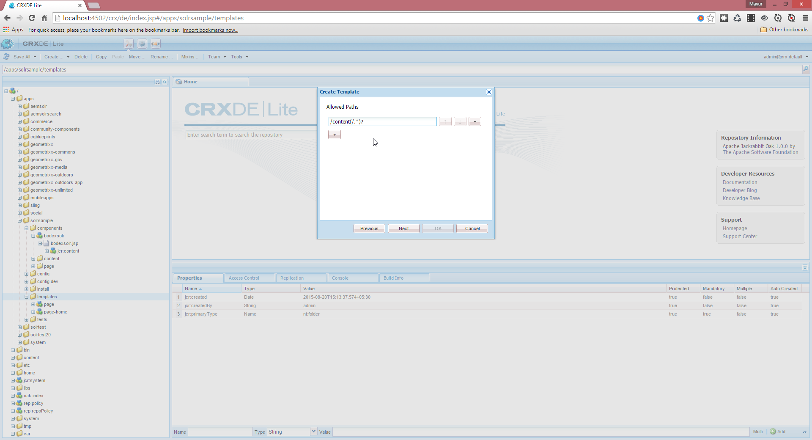
AEM project creation
Generate AEM Project from Adobe AEM archetype
project

Slide 34
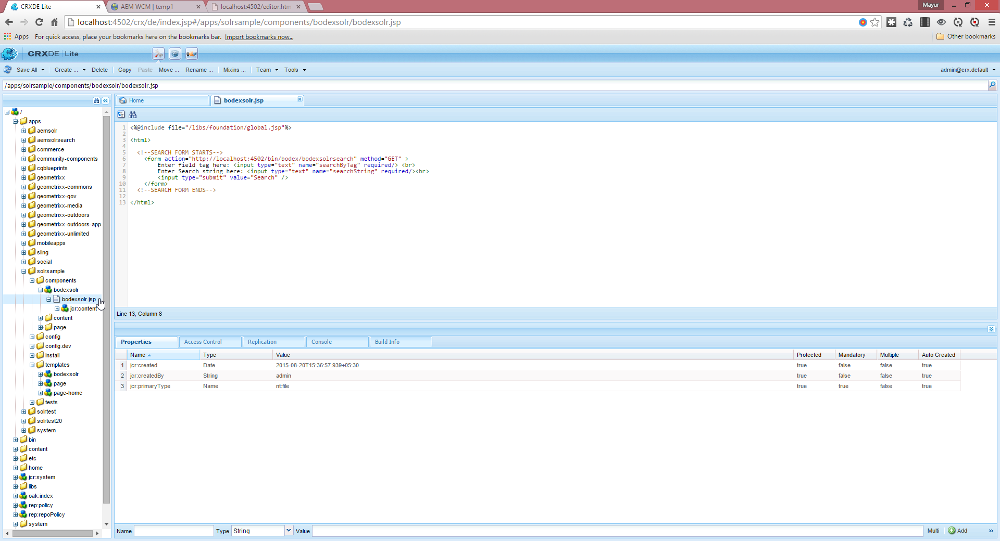
AEM project creation
Generate AEM Project from Adobe AEM archetype
project

Slide 35
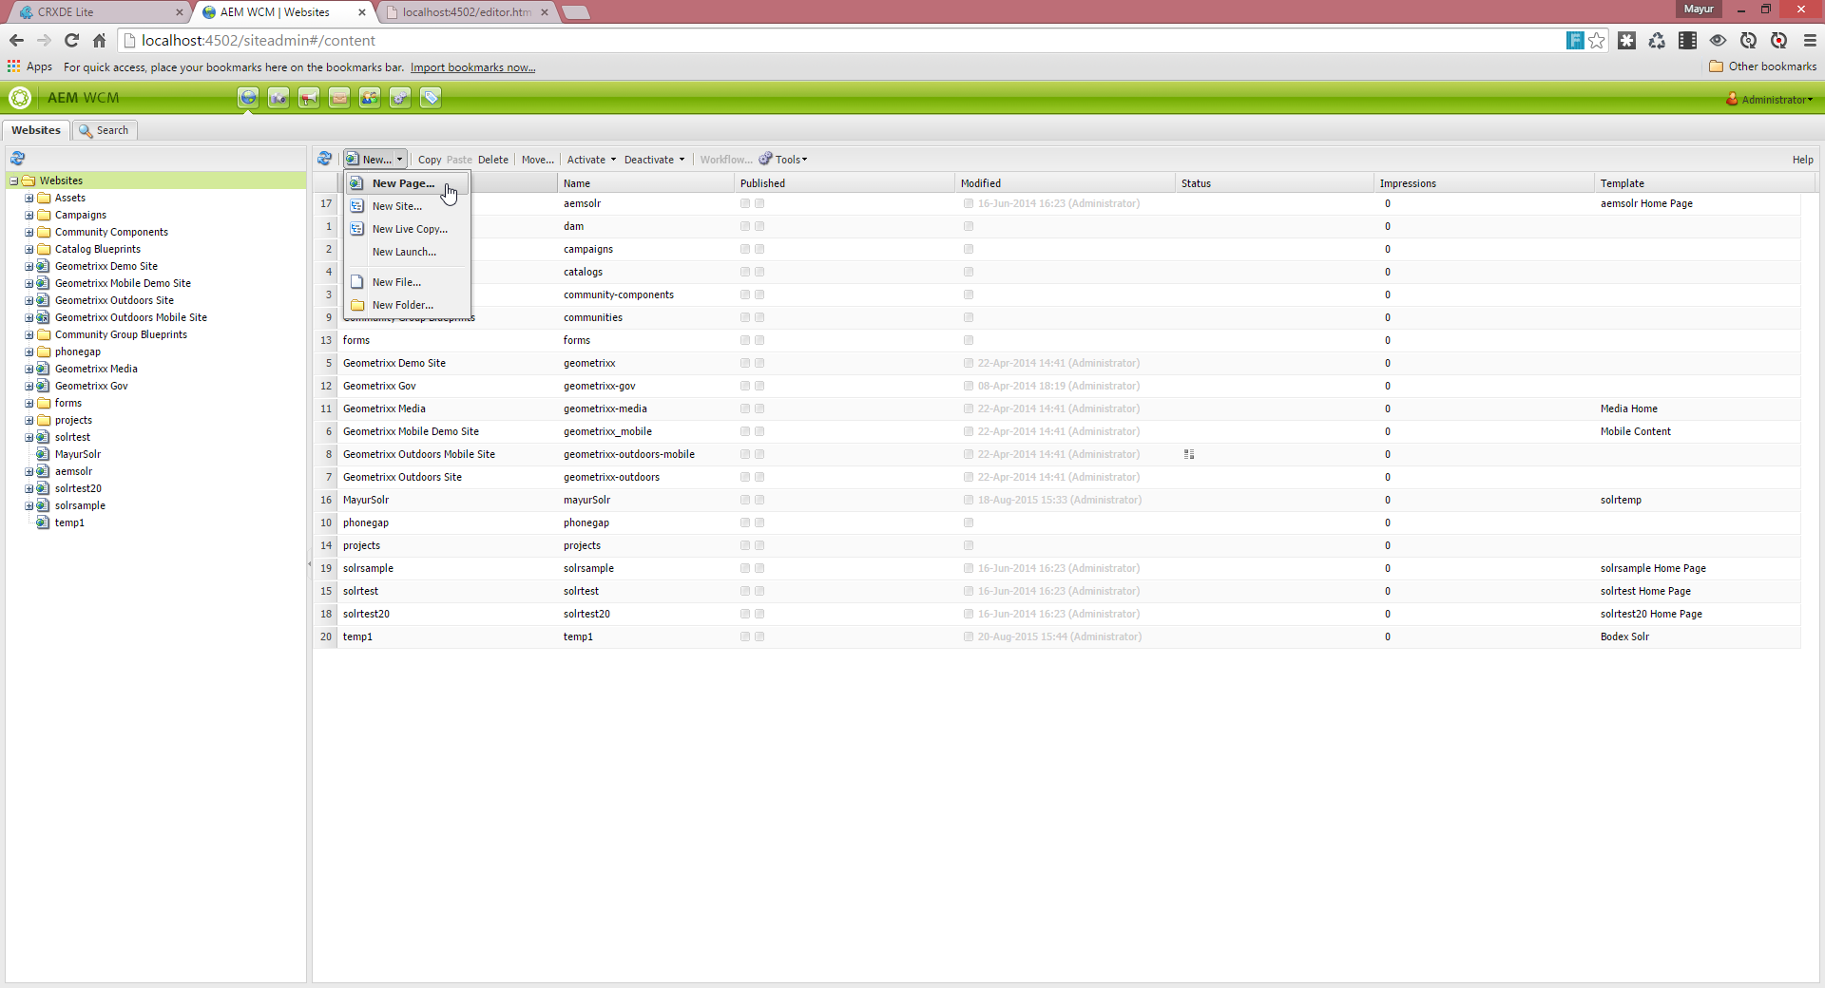
AEM project creation
Generate AEM Project from Adobe AEM archetype
project

Slide 36
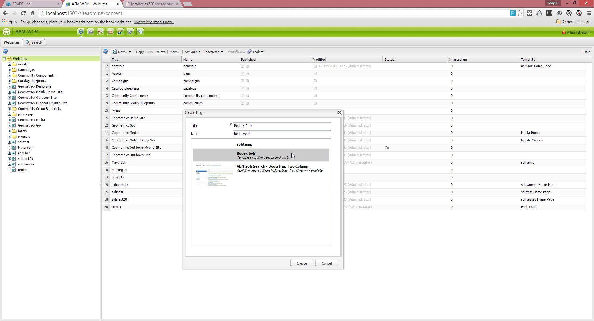
AEM project creation
Generate AEM Project from Adobe AEM archetype
project

Slide 37
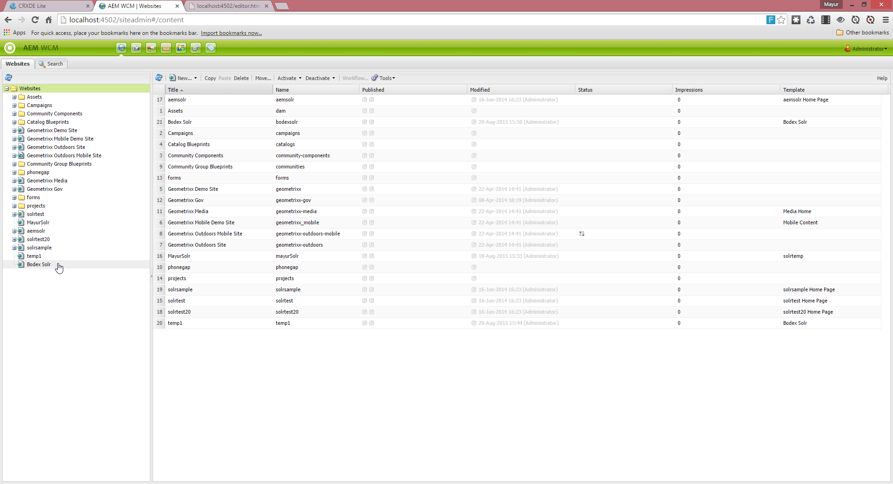
AEM project creation
Generate AEM Project from Adobe AEM archetype
project

Slide 38
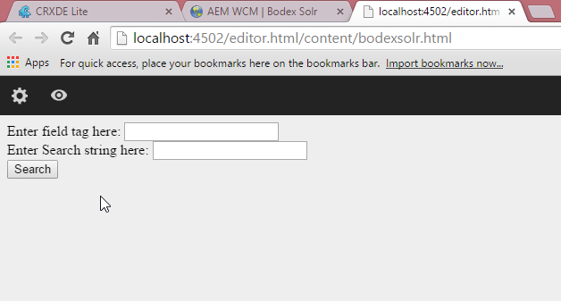
AEM project creation
Generate AEM Project from Adobe AEM archetype
project

Slide 39
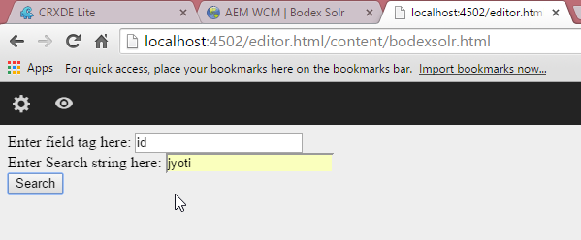
AEM project creation
Generate AEM Project from Adobe AEM archetype
project

Slide 40
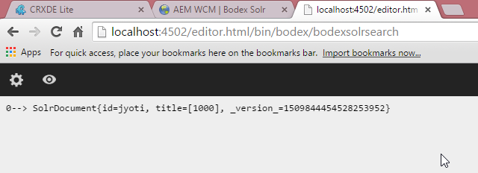
AEM project creation
Generate AEM Project from Adobe AEM archetype
project

Slide 41
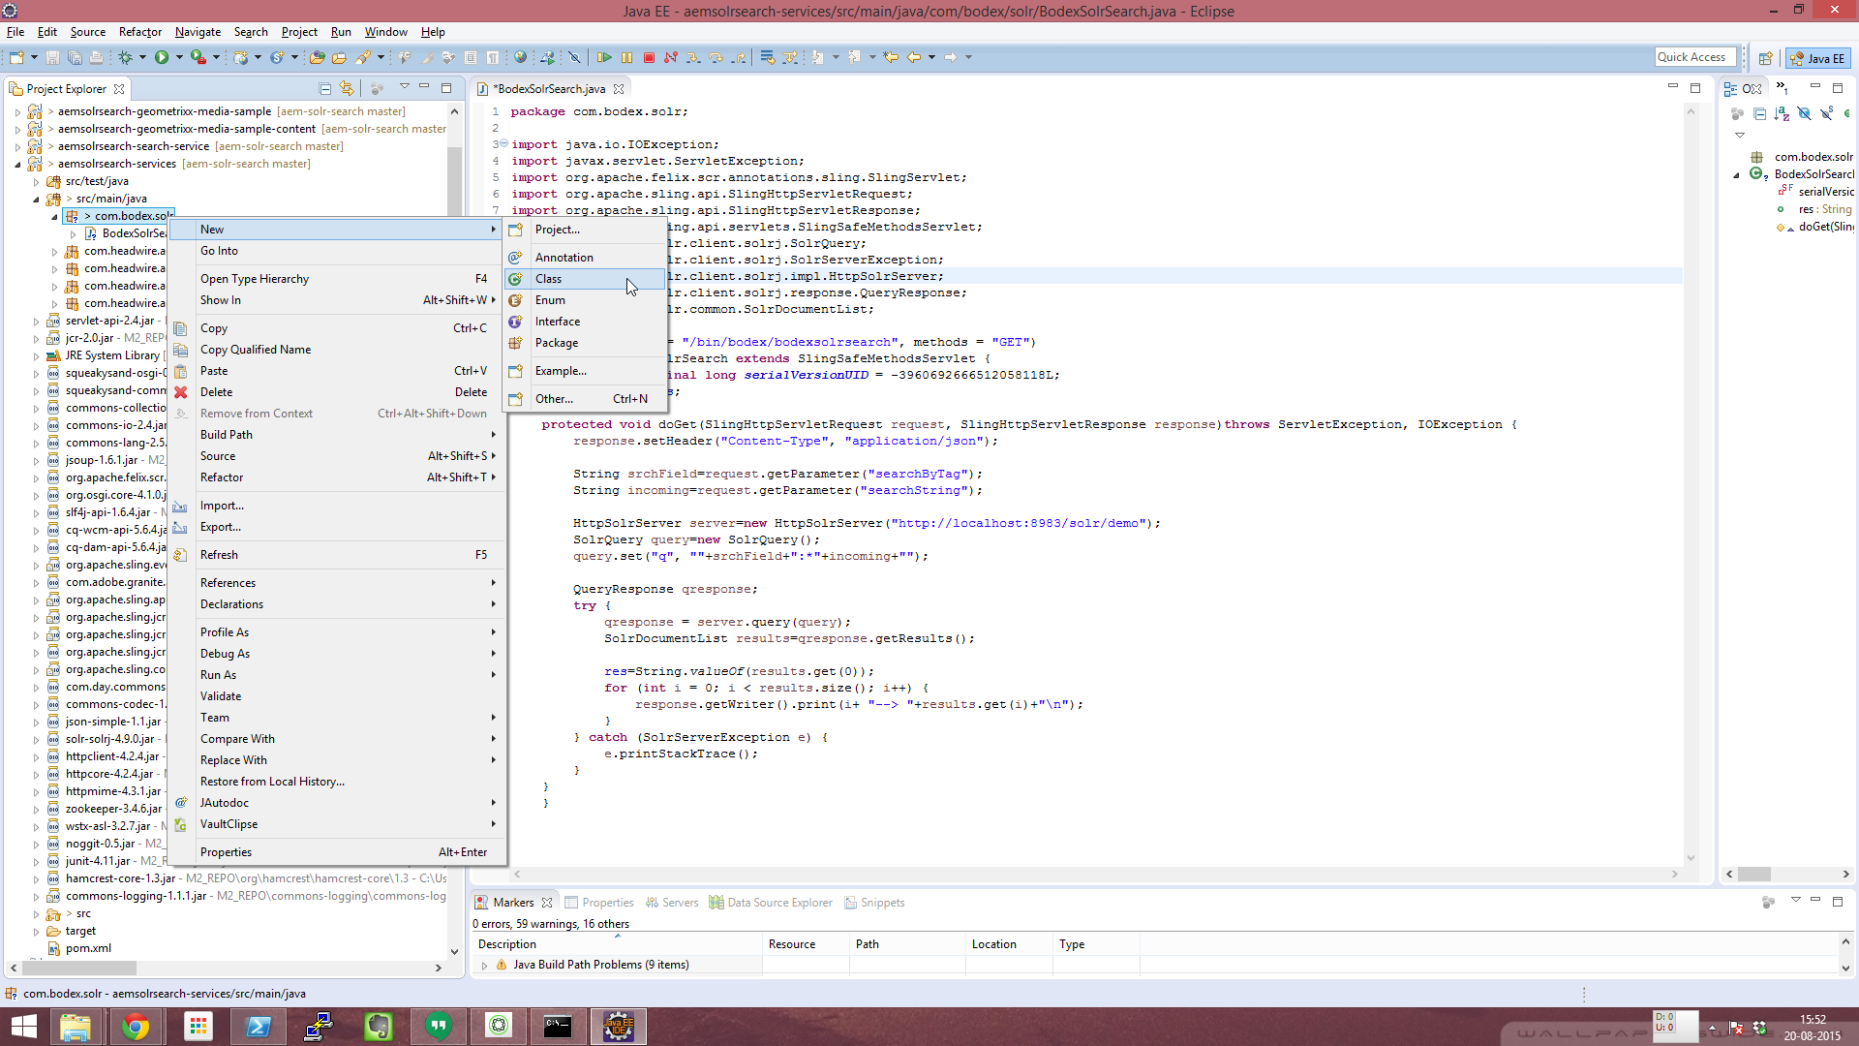
AEM project creation
Generate AEM Project from Adobe AEM archetype
project

Slide 42

AEM project creation
Generate AEM Project from Adobe AEM archetype
project

Slide 43
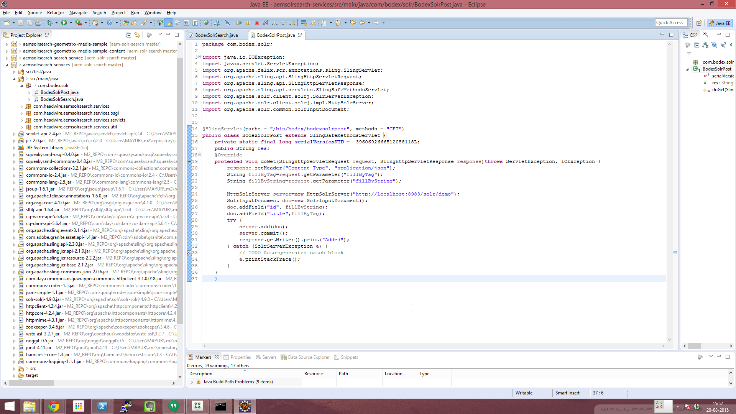
AEM project creation
Generate AEM Project from Adobe AEM archetype
project

Slide 44
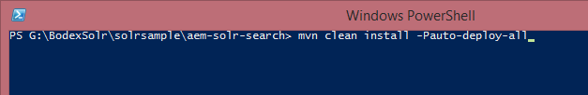
AEM project creation
Generate AEM Project from Adobe AEM archetype
project

Slide 45
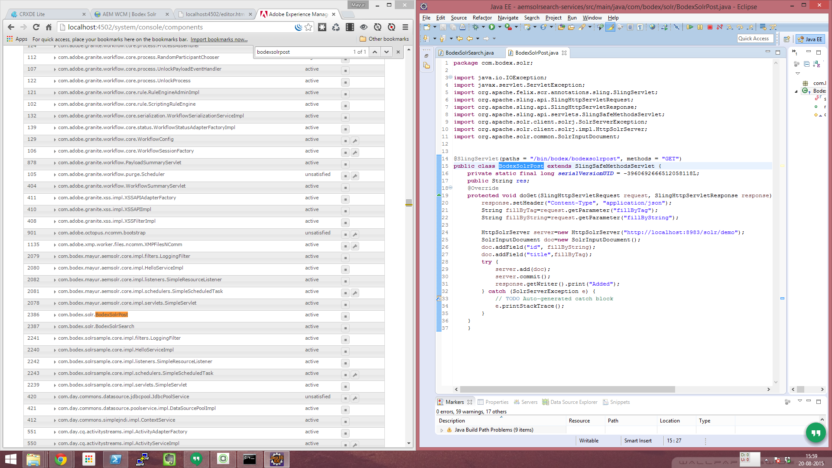
AEM project creation
Generate AEM Project from Adobe AEM archetype
project

Slide 46
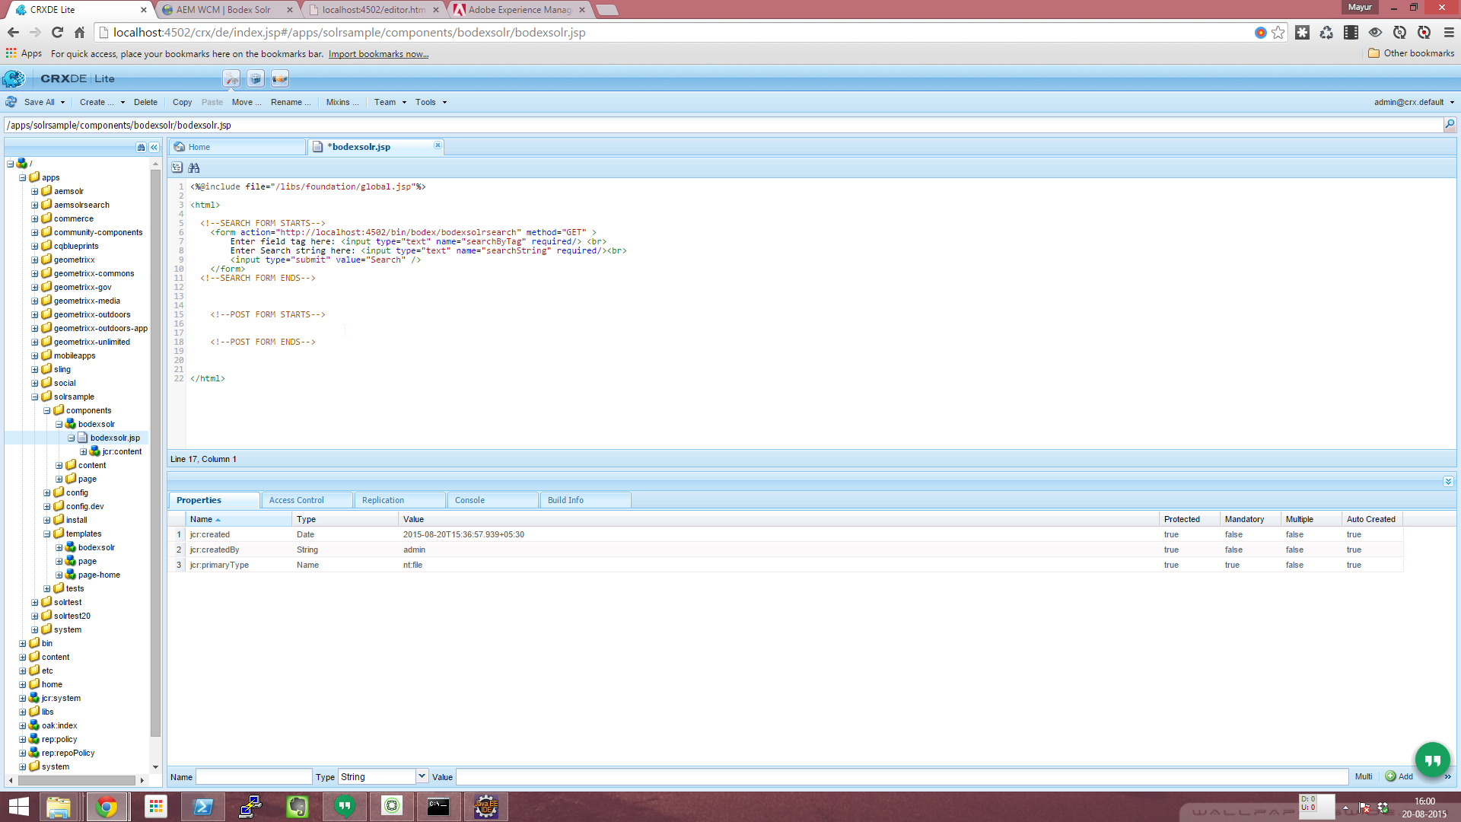
AEM project creation
Generate AEM Project from Adobe AEM archetype
project

Slide 47
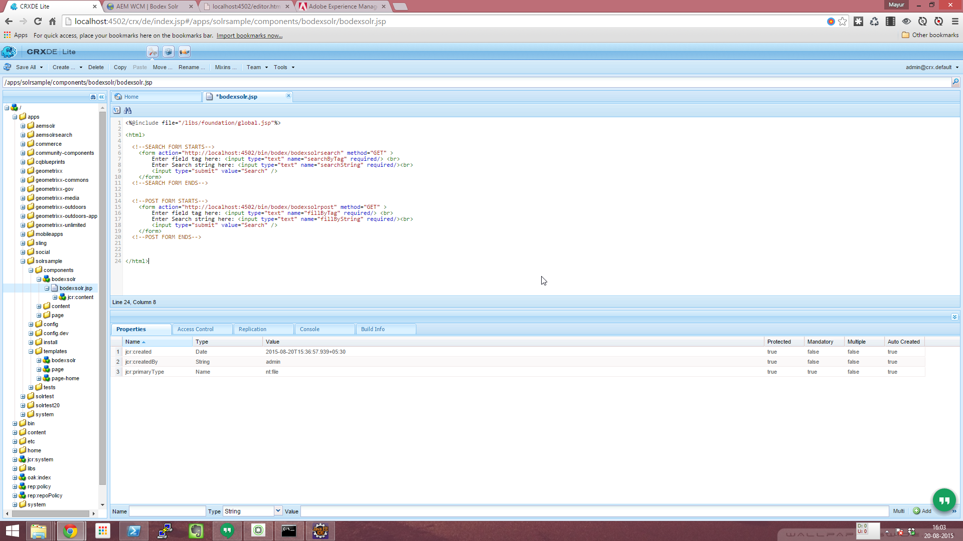
AEM project creation
Generate AEM Project from Adobe AEM archetype
project

Slide 48

AEM project creation
Generate AEM Project from Adobe AEM archetype
project

Slide 49
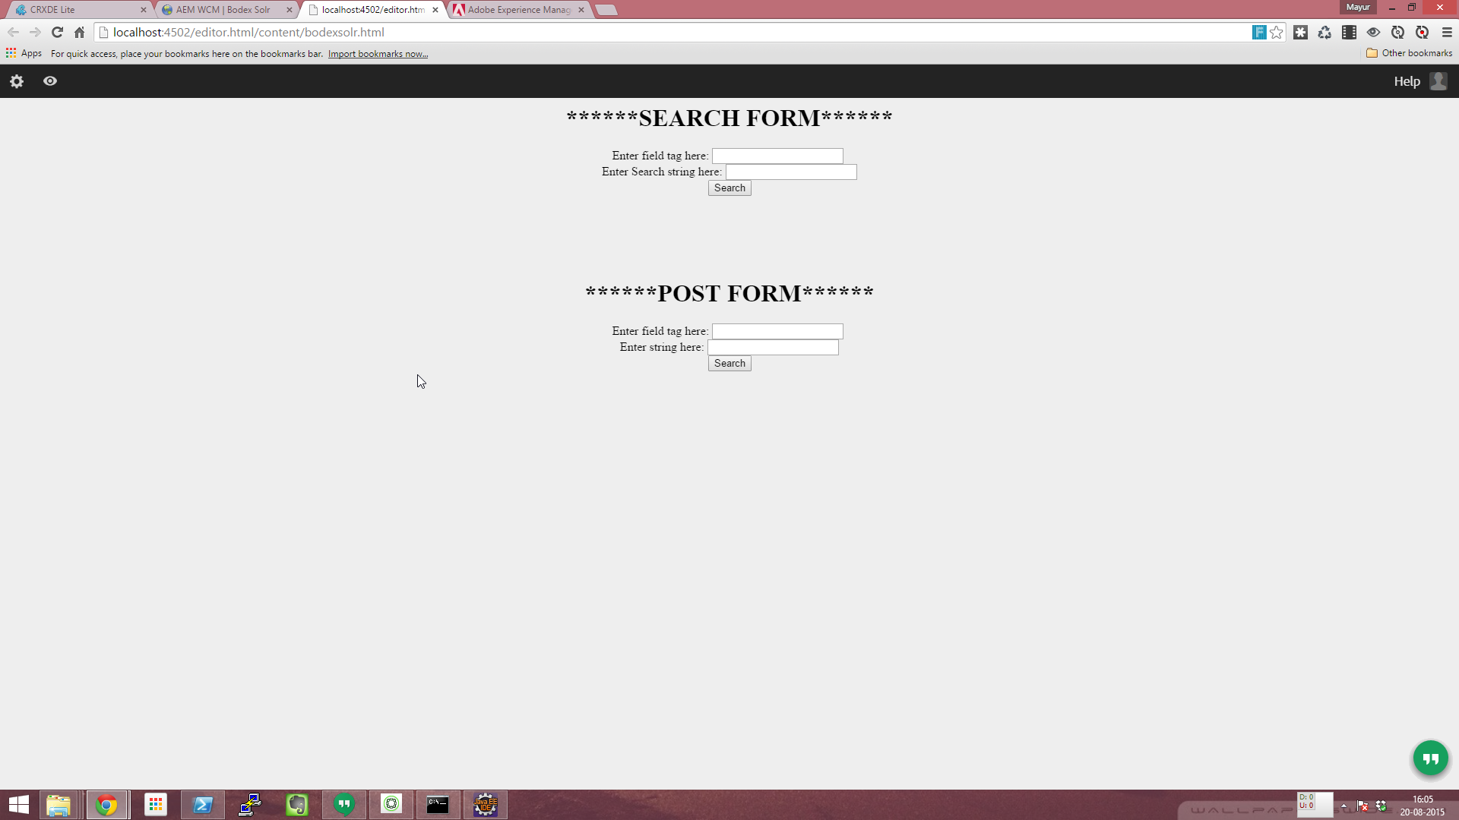
AEM project creation
Generate AEM Project from Adobe AEM archetype
project

Slide 50
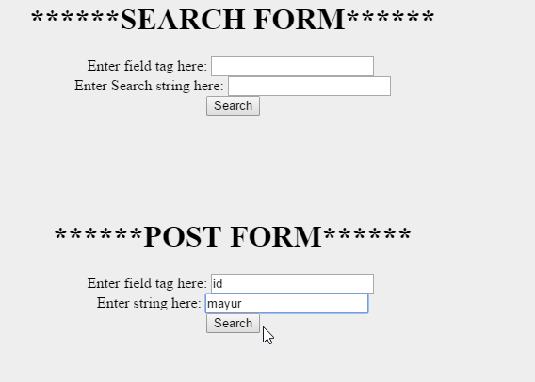
AEM project creation
Generate AEM Project from Adobe AEM archetype
project

Slide 51
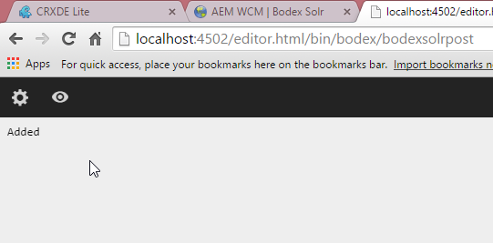
AEM project creation
Generate AEM Project from Adobe AEM archetype
project

Slide 52
AEM Solr Integration
AEM Solr Integration in Brief
project

Slide 53



Indexing Data Overview
AEM
Solr Instance
Running on port 8983
Indexed Doc
JCR
1
Event Listener
I will fire an action(SolrIndexer.java) whenever I observe changes in JCR Nodes
2
Java program [ SolrIndexer.java]
I will connect to Solr Instance (via Solrj API)
Build a query to insert/modify solr doc, in sync with AEM Content
Execute the query in Solr
Connect to Solr Instance :
http://localhost:8983/solr/Bodex
Core: Bodex
3
4
Execute Query: Index/Re-index Docs

Slide 54
Indexing Data Overview
Event Listener
I will fire an action(SolrIndexer.java) whenever I observe changes in JCR Nodes
Java program [ SolrIndexer.java]
Get a Solr Instance (via Solrj API)
Build a query to insert/modify solr doc, in sync with AEM Content and commit the changes made.
Execute the query in Solr
public class JCRContentListener implements EventListener
protected void activate(ComponentContext context) throws Exception {
observationManager.addEventListener(this, Event.PROPERTY_ADDED | Event.PROPERTY_CHANGED, "/", true, null,null, true);
}
public void onEvent(EventIterator it)
{
SolrIndexer SI=new SolrIndexer();
}
Public class SolrIndexer
{
public SolrIndexer()
{
HttpSolrServer server=new HttpSolrServer("http://localhost:8983/solr/demo");
SolrInputDocument doc=new SolrInputDocument();
doc.addField("id", incoming);
doc.addField("title",srchField);
server.add(doc);
server.commit();
}
}

Slide 55

Querying Data
AEM
Solr Instance
Running on port 8983
Search Form
Indexed doc
1
Sends back results
Sends form data to sling Servlet
5
Request
Sling Servlet (GET/POST)
Connect to Solr Instance
i will use form data(request parameters) to build query against Solr,
Execute query against Solr, and get the query results{JSON,XML,CSV}
and give search results back to the form as a response
2
Connect to Solr Instance :
http://localhost:8983/solr/Bodex
3
Core: Bodex
Execute Query and get results
4
Response

Slide 56
Querying Data Overview
<form action="http://localhost:4502/bin/bodex/solrsearch" method="GET" >
Enter field tag here: <input type="text" name="searchByTag" required/> <br>
Enter Search string here: <input type="text" name="searchString" required/><br>
<input type="submit" value="Search" />
</form>
AEM
Html form
Search Form
@SlingServlet(paths = "/bin/bodex/solrsearch", methods = "GET")
public class SearchSolr extends SlingSafeMethodsServlet {
protected void doGet(SlingHttpServletRequest request, SlingHttpServletResponse response)throws
ServletException, IOException {
String incoming=request.getParameter("srchstr");
String srchField=request.getParameter("srchfield");
HttpSolrServer server=new HttpSolrServer("http://localhost:8983/solr/demo");
SolrQuery query=new SolrQuery();
query.set("q", ""+srchField+":*"+incoming+"");
QueryResponse qresponse;
qresponse = server.query(query);
SolrDocumentList results=qresponse.getResults();
res=String.valueOf(results.get(0));
for (int i = 0; i < results.size(); i++) {
response.getWriter().print(i+ "--> "+results.get(i)+"\n");}}
1
Sends form data to sling Servlet
5
Request
Sling Servlet (GET/POST)
Connect to Solr Instance
i will use form data(request parameters) to build query against Solr,
Execute query against Solr, and get the query results{JSON,XML,CSV}
and give search results back to the form as a response
4
Sling Servlet
Response
Slide # 56

Slide 57
Thanks!

